Slide 1
LexID
Boshan Mo
Daniel Kim
Emily Powell
Jeff Zhu
Rabee Adil Jamshed

Slide 2
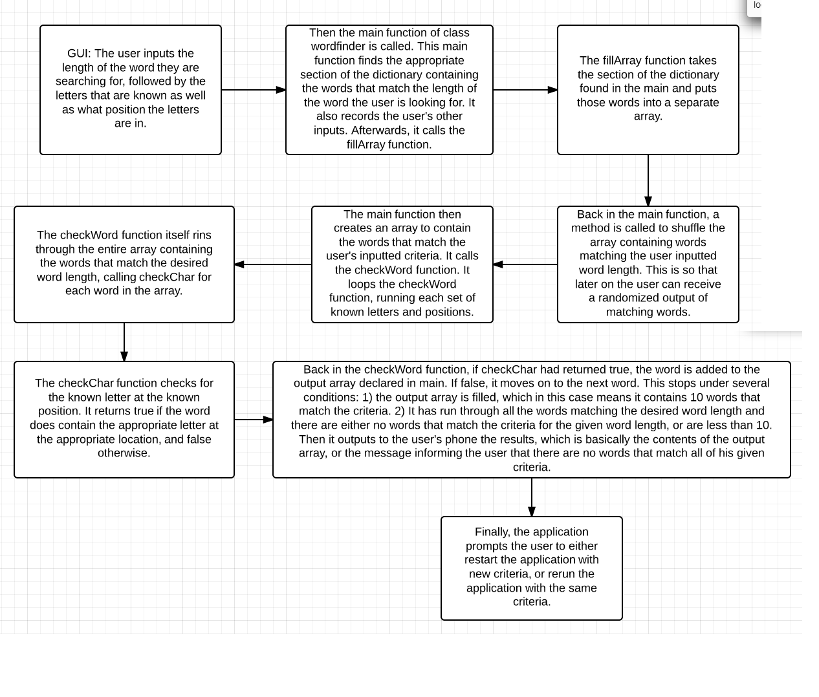
UML Diagram

Slide 3
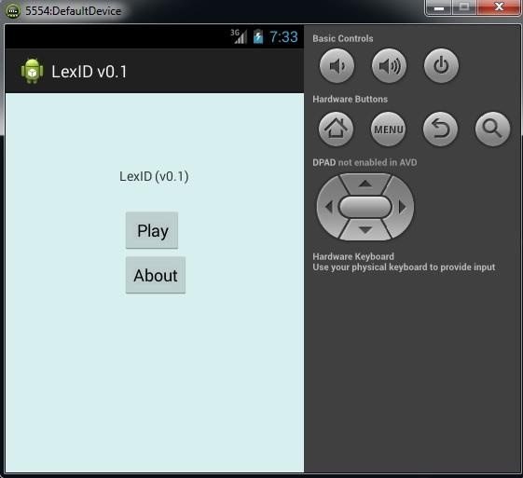
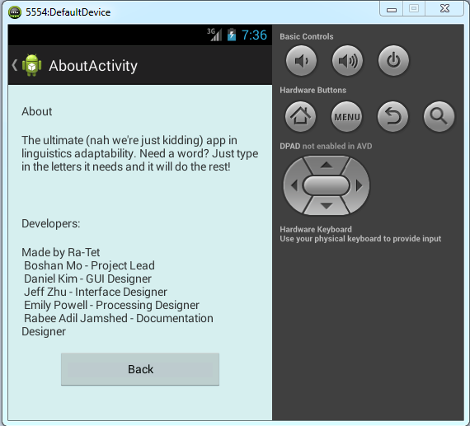
Front end Programming
User interface:
Upon startup the app gives the user two options
If the user chooses to play, he/she is asked to input the length of their word of choice.
If the user chooses to learn more about the program, he/she is redirected to the credits page.

Slide 4
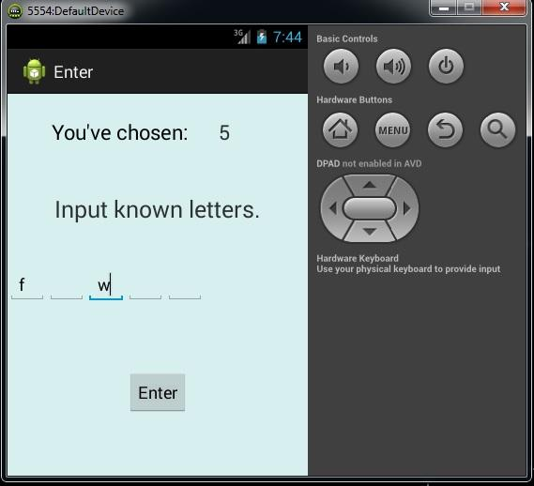
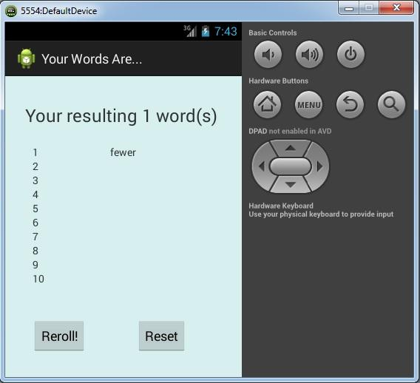
Front end Programming
If the user chooses to play they are asked to enter the length of the word.
The user is then asked to input their desired specific criteria.
The user is then provided with a random list of ten words, that fit the criteria.
User is prompted to either play again or rerun the program.

Slide 5
Back-end Programming
1) Main function of the class wordfinder:
called to find the appropriate section of the dictionary that contains the words of the requested length.
after performing its task, it calls the fillarray function
creates an output array for all the words that match the specified criteria
once the output array has been filled by the checkword function, the elements of the array are shuffled
the shuffling ensures the user is provided with a randomized list of ten words which is printed out

Slide 6
Back-end Programming
2) Fillarray function:
copies the relevant word list into a new array
the new array is passed to the checkword function
3) Checkword function:
finds all the words in the new array that match the specified criteria
the words that match the criteria are passed to the main function, which stores them in a pre allocated array.
stops if the output array is full, or when it reaches the end of the list.

